Slide 1


The Self-Driving Pizza Car:
Nischal Sinha
Great Oak High School
Bryce Ferguson
Department of Electrical and Computer Engineering University of California, Santa Barbara
Optimizing Control Algorithms for Autonomous Delivery Systems
UCSB Research Mentorship Program
August 1, 2019

Slide 2
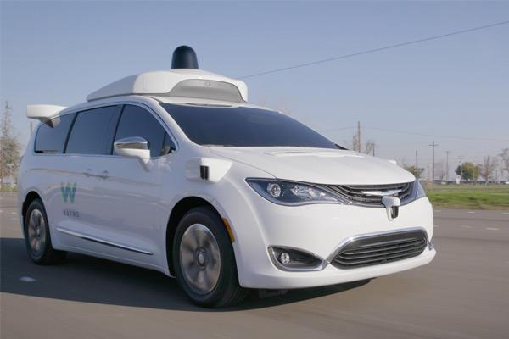
Autonomous Fleets
Research in autonomous vehicles has seen significant attention in recent years
Self-driving delivery networks are an exciting subset of this field
Little research done in managing these autonomous fleets
Waymo
Notes:
Fully autonomous vehicles have become an increasingly popular item of both public and scientific attention, with major companies like Tesla, Chrysler, and Alphabet involved.
Within this broader field, networks of autonomous delivery cars are a fascinating new field. With companies such as Walmart, Kroger, GM, and Doordash getting involved, self-driving delivery fleets are likely to become more prevalent in the near future.
While the creation and programming of an individual self-driving car has been extensively researched to put them on the road, there is much less literature on the mechanics of controlling a delivery fleet.

Slide 3
SDPC
Continually receives orders
Decides which order to satisfy
Bakes pizza as it drives
Moves to deliver order

Slide 4
SDPC
Continually receives orders
Decides which order to satisfy
Bakes pizza as it drives
Moves to deliver order

Slide 5
Why Pizza?
Multiple Factors
Other Applications
$9.8B
1
¹ Statista.
Notes:
US: $9.8B spent on pizza delivery in 2018¹
Major chains are looking for a way to increase profits
Self-Driving Pizza Car: SDPC
Many factors at play
Wait time, distance, order price, bake time…
Impacts in perishable good delivery, ride-sharing, and processor design

Slide 6
Why Pizza?
Multiple Factors
Other Applications
$9.8B
1
¹ Statista.
Notes:
US: $9.8B spent on pizza delivery in 2018¹
Major chains are looking for a way to increase profits
Self-Driving Pizza Car: SDPC
Many factors at play
Wait time, distance, order price, bake time…
Impacts in perishable good delivery, ride-sharing, and processor design

Slide 7
Why Pizza?
Multiple Factors
Other Applications
$9.8B
1
¹ Statista.
Notes:
US: $9.8B spent on pizza delivery in 2018¹
Major chains are looking for a way to increase profits
Self-Driving Pizza Car: SDPC
Many factors at play
Wait time, distance, order price, bake time…
Impacts in perishable good delivery, ride-sharing, and processor design

Slide 8
Our Research Goals
Develop
Develop
Analyze
Model
Analyze
Model
Notes:
Model an environment to simulate a network with an SDPC.
Develop Greedy and TD control algorithms for a variety of parameters
Analyze the delivery efficiencies of these algorithms to determine their effectiveness for SDPC delivery

Slide 9
Our Research Goals
Model
Notes:
Model an environment to simulate a network with an SDPC.
Develop Greedy and TD control algorithms for a variety of parameters
Analyze the delivery efficiencies of these algorithms to determine their effectiveness for SDPC delivery

Slide 10
Our Research Goals
Model
Develop
Notes:
Model an environment to simulate a network with an SDPC.
Develop Greedy and TD control algorithms for a variety of parameters
Analyze the delivery efficiencies of these algorithms to determine their effectiveness for SDPC delivery

Slide 11
Our Research Goals
Model
Develop
Analyze
Model
Develop
Analyze
Notes:
Model an environment to simulate a network with an SDPC.
Develop Greedy and TD control algorithms for a variety of parameters
Analyze the delivery efficiencies of these algorithms to determine their effectiveness for SDPC delivery

Slide 12
|
Model
Develop
Analyze
Framework
2
3
Graph with n nodes
Nodes = locations
Edges = distances
Randomly generating orders
Bake time
Price
Wait time
SDPC
1
5
4

Slide 13
|
Model
Develop
Analyze
Framework
2
3
Graph with n nodes
Nodes = locations
Edges = distances
Randomly generating orders
Bake time
Price
Wait time
SDPC
1
5
4

Slide 14
|
2
3
Model
Develop
Analyze
Decision Making
SDPC
1
Determine state x(t)
Find control that minimizes cost
Execute control
5
4
Notes:
The total cost associated with satisfying an order is represented by a modified form of this equation.

Slide 15
|
Model
Develop
Analyze
Control Algorithms
Temporal Difference
Greedy
Estimates cumulative benefit
Learns from its own behavior
Doesn’t need existing data
Look for immediate benefit
Rigid, does not explore surroundings
Typically need data
Notes:
Two major approaches we examined are traditional decision making (control) algorithms, and reinforcement learning ones
Traditional algorithms use a static control policy to make decisions; these are usually generated from existing data and can be inefficient on large networks or new areas
RL is a more adaptable approach to control algorithms. Here the program “learns” from its mistakes and constantly improves its predictions for the particular system. However, little RL research has been done for routing problems like SDPCs, and those that has only focuses on individual cars.
Finally, to our knowledge no routing solutions have been posed that factor in the SDPC constraint of bake time per order

Slide 16
|
Model
Develop
Analyze
TD Algorithm
Approximate state cost
Determine allowable controls
Evaluate terminal cost $g$ for each control
Evaluate terminal cost 𝑔 for each control
Draw control randomly from costs
Output next state x⁺
Evaluate temporal difference
Evaluate expected cost$: \tilde{J}=\sum{r⋅φ}$
Evaluate expected cost: 𝐽 ̃=∑▒〖𝑟⋅𝜑〗
Determine total cost per control as $g+\tilde{J}$
Determine total cost per control as 𝑔+𝐽 ̃
Update weights
Notes:
After the car decides a target, it will move to that location along the edges.

Slide 17
|
Model
Develop
Analyze
TD Algorithm
Approximate state cost
Determine allowable controls
Evaluate terminal cost $g$ for each control
Evaluate terminal cost 𝑔 for each control
Draw control randomly from costs
Output next state x⁺
Evaluate temporal difference
Evaluate expected cost$: \tilde{J}=\sum{r⋅φ}$
Evaluate expected cost: 𝐽 ̃=∑▒〖𝑟⋅𝜑〗
Determine total cost per control as $g+\tilde{J}$
Determine total cost per control as 𝑔+𝐽 ̃
Update weights
Notes:
After the car decides a target, it will move to that location along the edges.

Slide 18
|
Model
Develop
Analyze
TD Algorithm
Approximate state cost
Determine allowable controls
Evaluate terminal cost $g$ for each control
Evaluate terminal cost 𝑔 for each control
Draw control randomly from costs
Output next state x⁺
Evaluate temporal difference
Evaluate expected cost$: \tilde{J}=\sum{r⋅φ}$
Evaluate expected cost: 𝐽 ̃=∑▒〖𝑟⋅𝜑〗
Determine total cost per control as $g+\tilde{J}$
Determine total cost per control as 𝑔+𝐽 ̃
Update weights

Slide 19
|
Model
Develop
Analyze
TD Algorithm
Approximate state cost
Determine allowable controls
Evaluate terminal cost $g$ for each control
Evaluate terminal cost 𝑔 for each control
Draw control randomly from costs
Output next state x⁺
Evaluate temporal difference
Evaluate expected cost$: \tilde{J}=\sum{r⋅φ}$
Evaluate expected cost: 𝐽 ̃=∑▒〖𝑟⋅𝜑〗
Determine total cost per control as $g+\tilde{J}$
Determine total cost per control as 𝑔+𝐽 ̃
Update weights

Slide 20
|
Model
Develop
Analyze
TD Algorithm
Approximate state cost
Determine allowable controls
Evaluate terminal cost $g$ for each control
Evaluate terminal cost 𝑔 for each control
Draw control randomly from costs
Output next state x⁺
Evaluate temporal difference
Evaluate expected cost$: \tilde{J}=\sum{r⋅φ}$
Evaluate expected cost: 𝐽 ̃=∑▒〖𝑟⋅𝜑〗
Determine total cost per control as $g+\tilde{J}$
Determine total cost per control as 𝑔+𝐽 ̃
Update weights

Slide 21
|
Model
Develop
Analyze
Target Properties
Minimum Distance
Maximum Price
Maximum Wait
Notes:
After the car decides a target, it will move to that location along the edges.

Slide 22
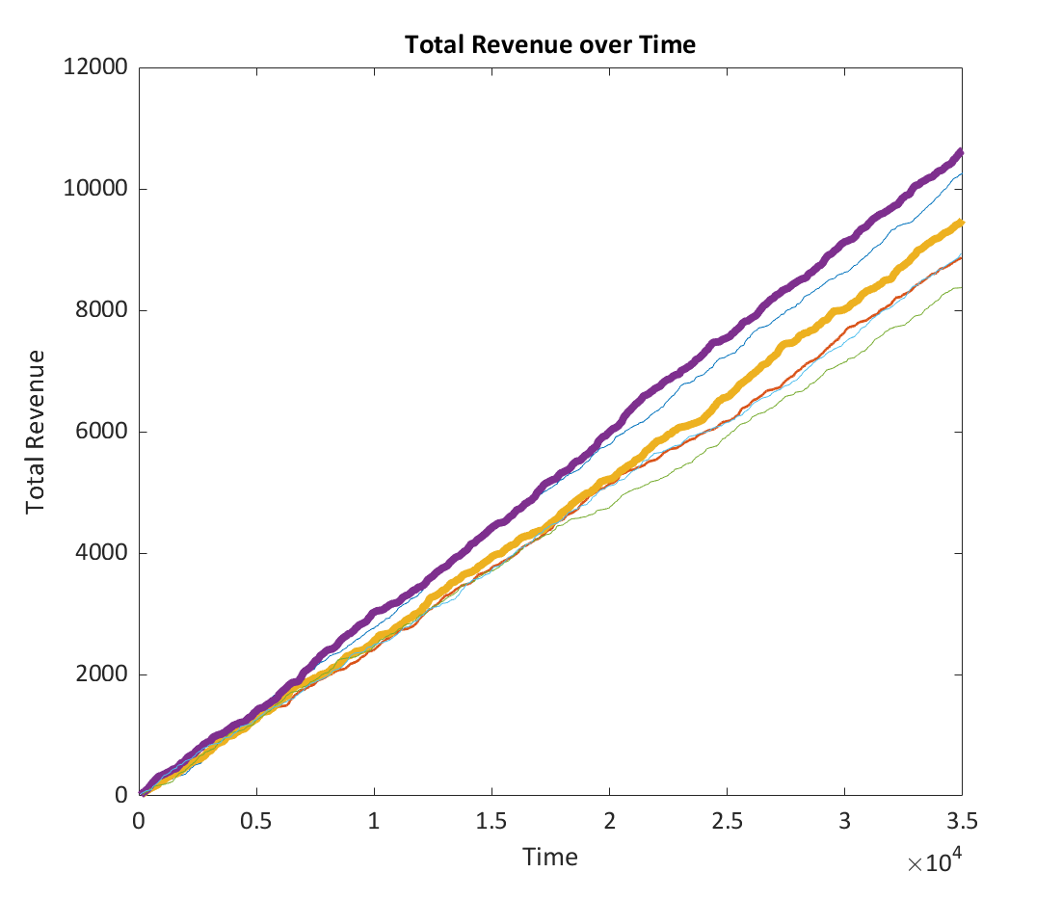
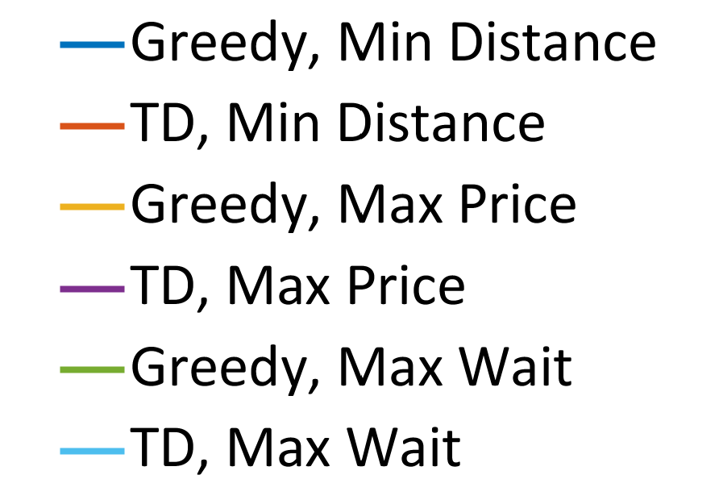
|
Model
Develop
Analyze
Notes:
After the car decides a target, it will move to that location along the edges.

Slide 23
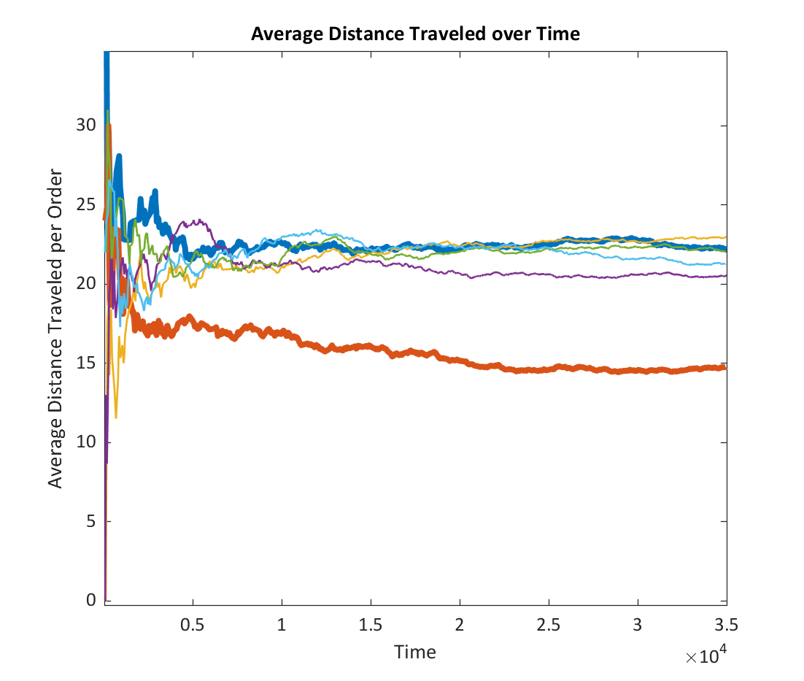
|
Model
Develop
Analyze
Notes:
After the car decides a target, it will move to that location along the edges.

Slide 24
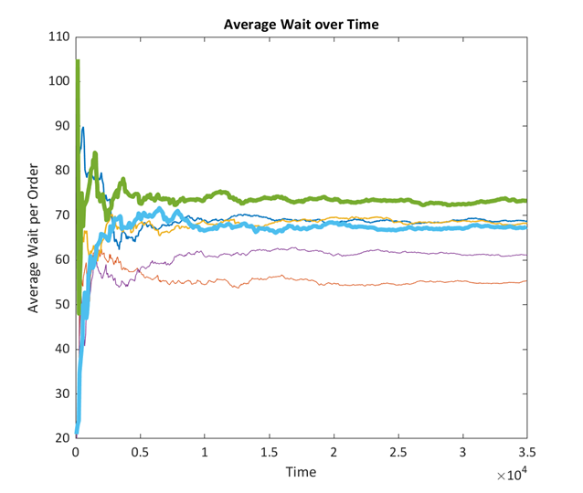

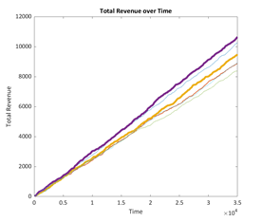
|
Model
Develop
Analyze
Notes:
After the car decides a target, it will move to that location along the edges.

Slide 25
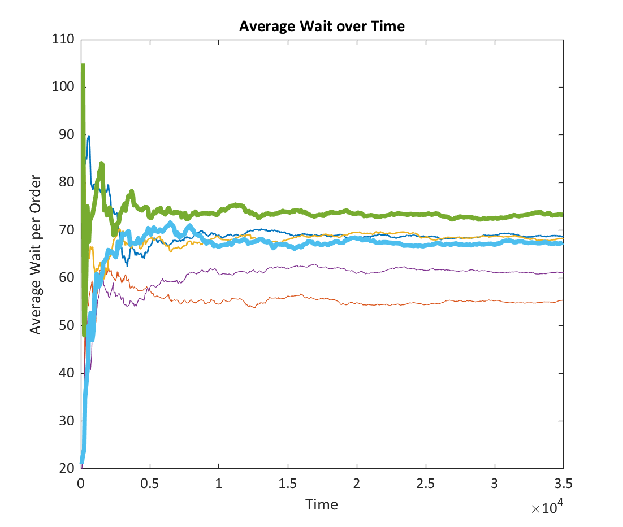
|
Model
Develop
Analyze
TD Algorithms consistently outperform greedy counterparts
TD, Min Distance performs the best over the most metrics
TD, Max Price performs best to maximize revenues
Notes:
After the car decides a target, it will move to that location along the edges.

Slide 26
Future Work
Increase robustness of model with multiple factors
Develop algorithm with optimal performance on all metrics
Expand model to apply to SDPC fleets
Notes:
After the car decides a target, it will move to that location along the edges.

Slide 27
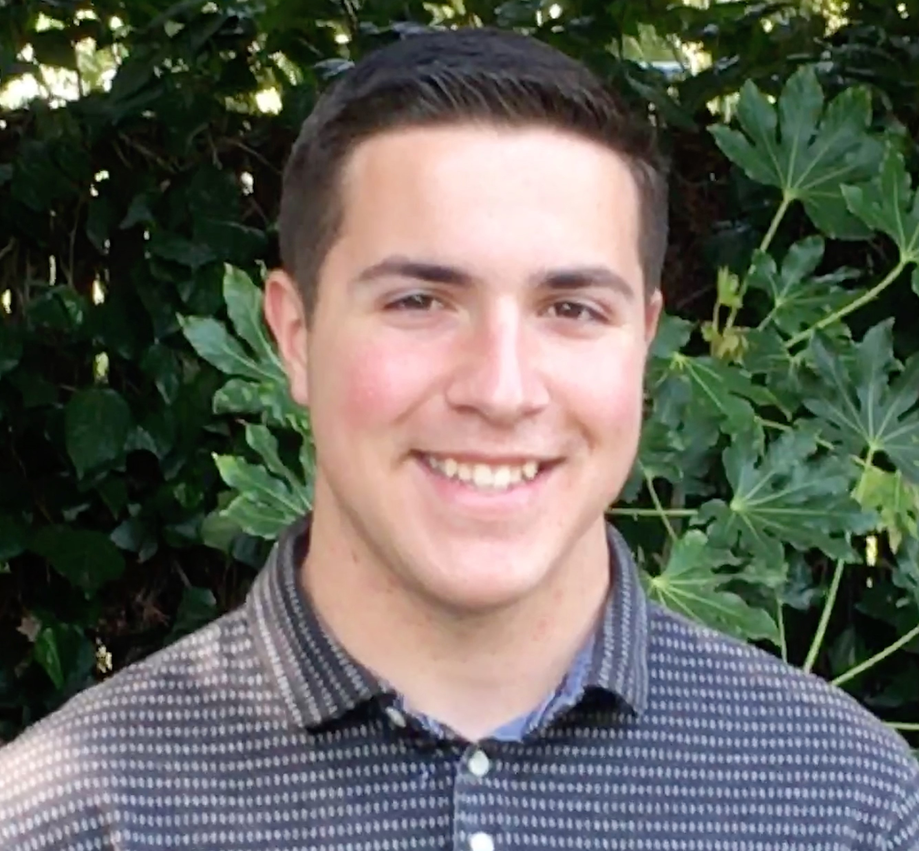

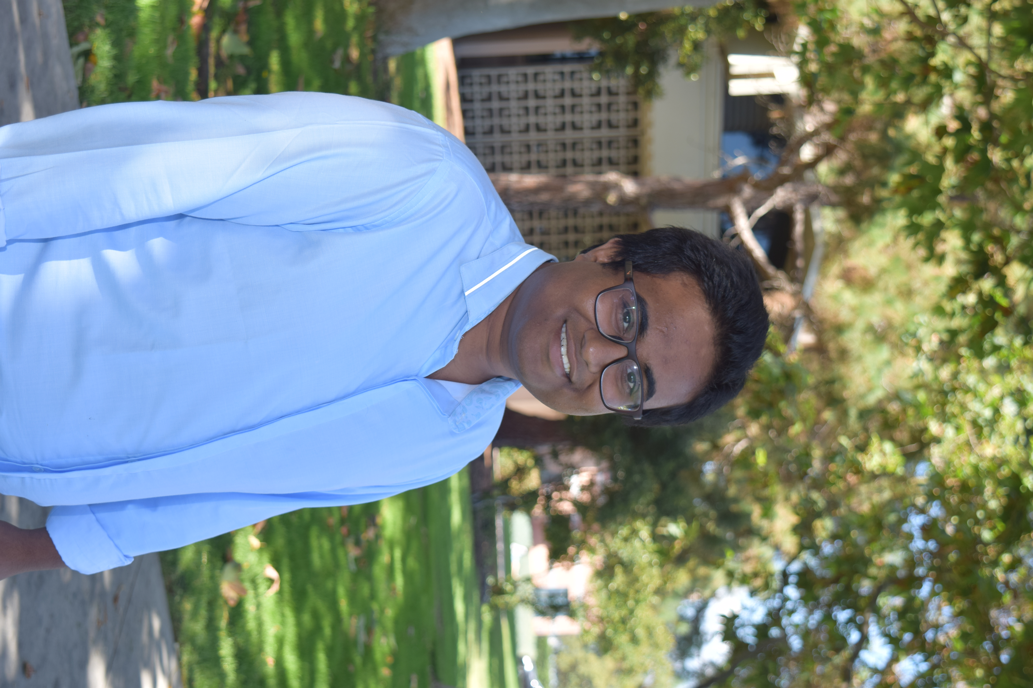

Acknowledgements
Bryce Ferguson
Dr. Lina Kim
A S M Iftekhar
UCSB ECE
Dr. Michael Hughes
Lab partners: Adit Shah, Siddharth Ganesan
Summer Discovery
Notes:
I’d like to thank Dr. Lina Kim, Dr. Michael Hughes, and ASM Iftekhar for

Slide 28
References
“Pizza delivery: consumer spending US 2018,” Statista. [Online]. Available: https://www.statista.com/statistics/259168/pizza-delivery-consumer-spending-in-the-us/. [Accessed: 14-Jul-2019].
P. Holley, “Domino’s will start delivering pizzas via an autonomous robot this fall,” Washington Post, 17-Jun-2019.
“Order Delicious Pizza and Have it Delivered Zume Fast,” Zume Pizza, Order Online. [Online]. Available: https://zumepizza.com/. [Accessed: 14-Jul-2019].
M. Han, P. Senellart, S. Bressan, and H. Wu, “Routing an Autonomous Taxi with Reinforcement Learning,” in Proceedings of the 25th ACM International on Conference on Information and Knowledge Management - CIKM ’16, Indianapolis, Indiana, USA, 2016, pp. 2421–2424.
N. J. Yuan, Y. Zheng, L. Zhang, and X. Xie, “T-Finder: A Recommender System for Finding Passengers and Vacant Taxis,” IEEE Trans. Knowl. Data Eng., vol. 25, no. 10, pp. 2390–2403, Oct. 2013.
M. Pavone, “19 Autonomous Mobility-on-Demand Systems for Future Urban Mobility,” p. 16.
D. Bertsekas, Dynamic Programming and Optimal Control, 3rd ed., vol. 1. Athena Scientific, 2005.
S. Shalev-Shwartz, S. Shammah, and A. Shashua, “Safe, Multi-Agent, Reinforcement Learning for Autonomous Driving,” arXiv:1610.03295 [cs, stat], Oct. 2016.
A. Sallab, M. Abdou, E. Perot, and S. Yogamani, “Deep Reinforcement Learning framework for Autonomous Driving,” Electronic Imaging, vol. 2017, no. 19, pp. 70–76, Jan. 2017.
K. Treleaven, M. Pavone, and E. Frazzoli, “Asymptotically Optimal Algorithms for Pickup and Delivery Problems with Application to Large-Scale Transportation Systems,” p. 36, 2012.
Notes:
I’d like to thank Dr. Lina Kim, Dr. Michael Hughes, and ASM Iftekhar for

Slide 29
Questions?

